Slide 1
I18N and L10N
Mark Lin
Dec. 2019

Slide 2
Agenda
What is i18n?
What is l10n?
i18n and l10n
Basic Guidelines
What needs to be localized?
What does NOT need to be put into l10n resource?
Q&A

Slide 3
What is i18n?
i18n: internationalization
Make an application international; that is, make it able to support virtually any language or local setting on Earth without modify source code. https://wiki.mageia.org/en/What_is_i18n,_what_is_l10n
One single application for ALL countries.

Slide 4
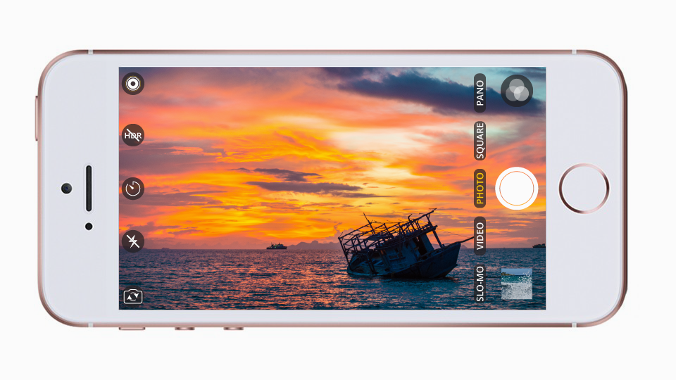
What is i18n?
Examples:
Sofware: Mobile phone camera.

Slide 5
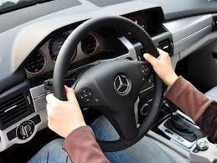
What is i18n?
Examples:
Car: Wheel…

Slide 6


What is i18n?
Examples:
Car: Wheel…
Men in Black II "What is a Gameboy"
https://www.youtube.com/watch?v=lDtwTqBwqwk&t=1m5s

Slide 7
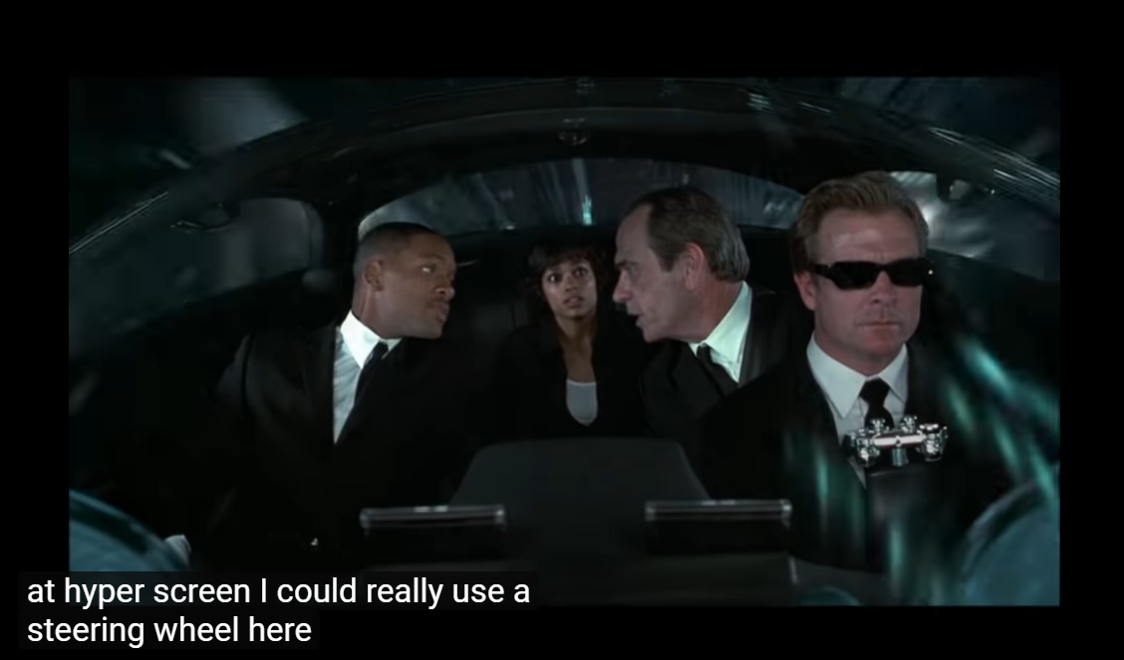
What is i18n?
Examples:
Car: Wheel…
Men in Black II "What is a Gameboy"
https://www.youtube.com/watch?v=lDtwTqBwqwk&t=1m5s

Slide 8

What is i18n?
Examples:
Car: Wheel…
Men in Black II "What is a Gameboy"
https://www.youtube.com/watch?v=lDtwTqBwqwk&t=1m5s

Slide 9
What is l10n?
l10n: localization
Make an application localized; that is, work for a given local and concrete context, adapted to the user. https://wiki.mageia.org/en/What_is_i18n,_what_is_l10n
Different application for different country?

Slide 10
What is l10n?
Examples:
Sofware: Disallow to disable Japan mobile phone’s camera shutter sound. https://www.engadget.com/2016/09/30/japans-noisy-iphone-problem/

Slide 11
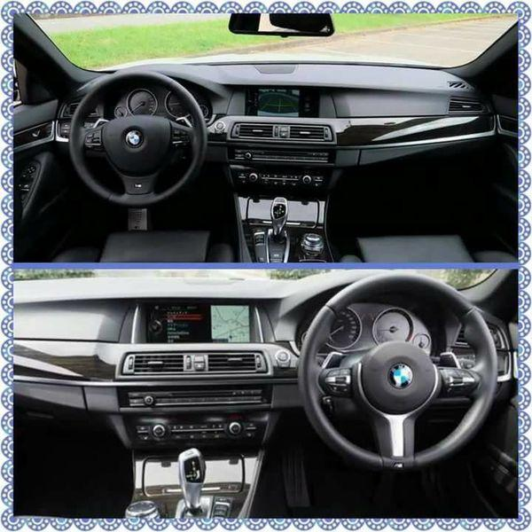
What is l10n?
Examples:
Car: Location of the wheel. Left or Right?

Slide 12
i18n and l10n
Conflict concept?
Not only do not conflict with each other, but also complement each other.
i18n makes it available to do l10n.
l10n increase its i18n.

Slide 13
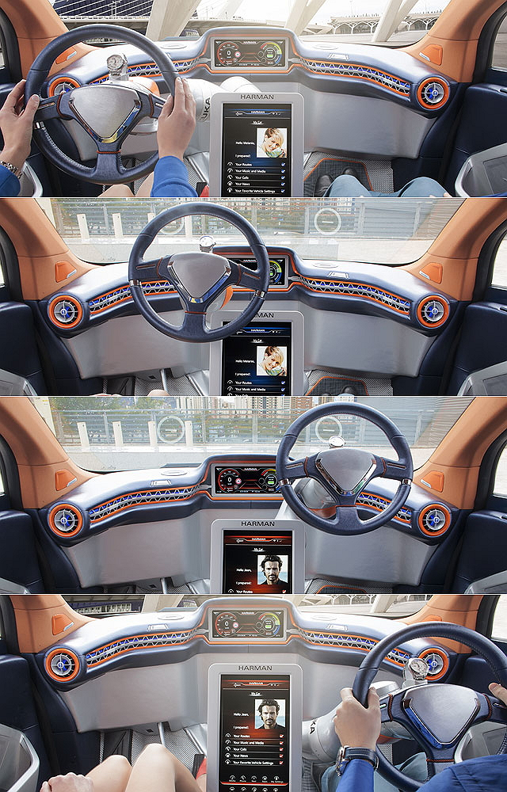
i18n and l10n

Slide 14
Basic Guidelines
Design for multi-languages. Not only designing for English/native language but also including support to other languages/cultures.
Layout / Text String Space.
Color/Font-family.
Functionality.
Encoding/Character set: Unicode.
Structure of the program.
Test plane.
Not hardcoded. Use variables
Extract all l10n target out of the source code, and put them into l10n resource folder/files.
Keep sentence complete and meaningful.
Do not split or cut sentences.

Slide 15
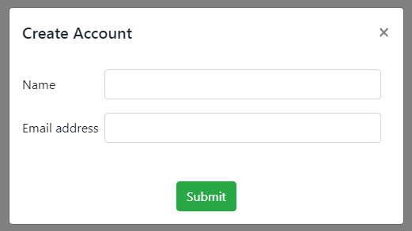
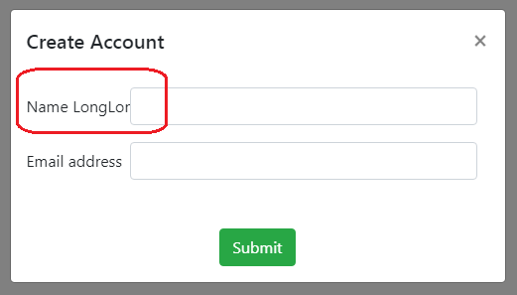
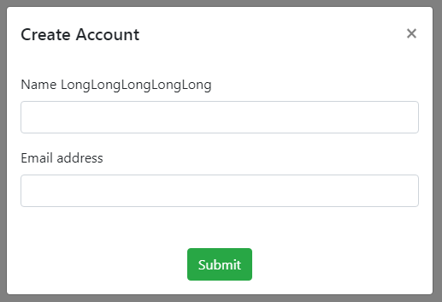
Basic Guidelines - Layout / Text String Space
Design for multi-languages.
Layout: Allow extra space for translations.
Because English is a compact size language. When the text string is translated into other languages, its text size will increase.
https://www.w3.org/International/articles/article-text-size.en

Slide 16
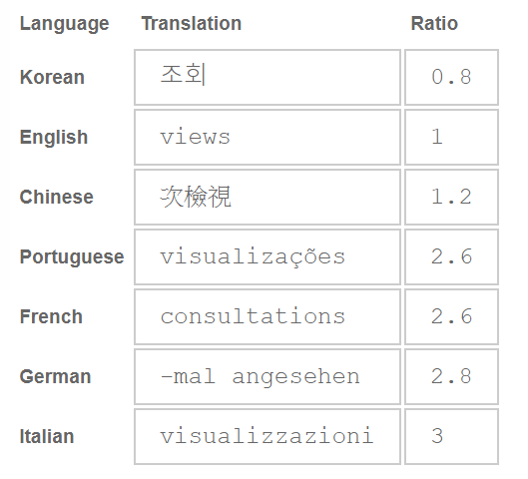
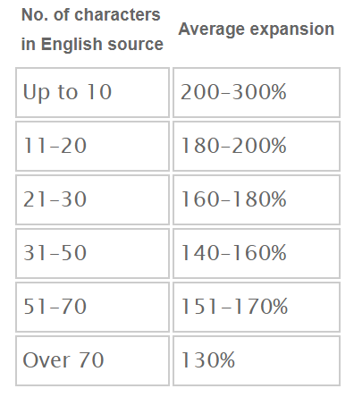
Basic Guidelines - Layout / Text String Space
Design for multi-languages.
Layout: Allow extra space for translations.
Because English is a compact size language. When the text string is translated into other languages, its text size will increase.
https://www.w3.org/International/articles/article-text-size.en

Slide 17
Basic Guidelines - Layout / Text String Space
Design for multi-languages.
Layout: Allow extra space for translations.
Compound nouns.
Right-to-left.
Text String in English | Input processing features
in German | Eingabeverarbeitungsfunktionen
in French | Fonctions de traitement d'entrée
in Arabic | وظائف معالجة المدخلات
https://www.w3.org/International/articles/article-text-size.en

Slide 18
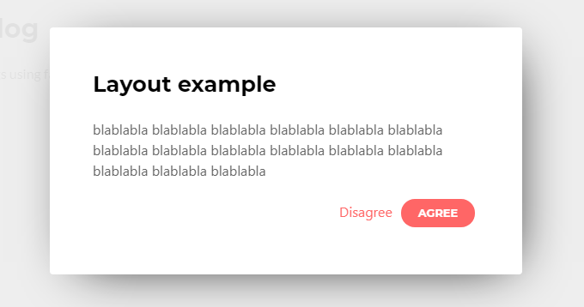
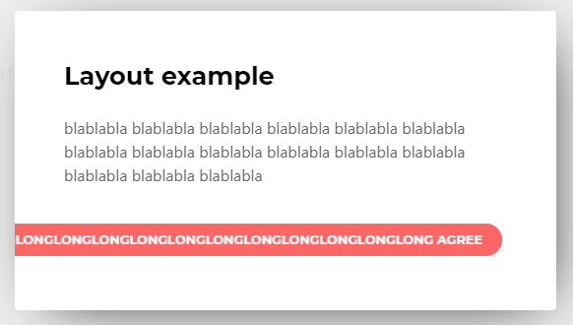
Basic Guidelines - Layout / Text String Space
Design for multi-languages.
Layout: Allow extra space for translations.

Slide 19
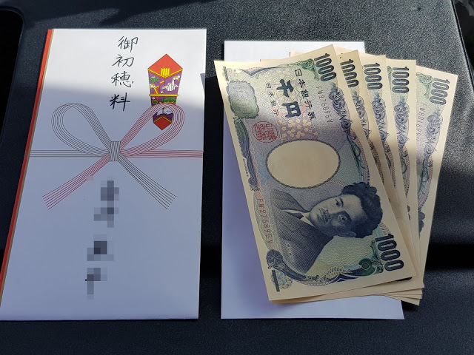
Basic Guidelines - Color / Font-Family
Design for multi-languages.
Color/Font-family. Be culture sensetive.
A white envelope with money inside.
⇒ What does it mean to you?
The meaning in Taiwan is different from Japan.
http://www.shamitsu.com/2018/10/blog-post_4.html

Slide 20
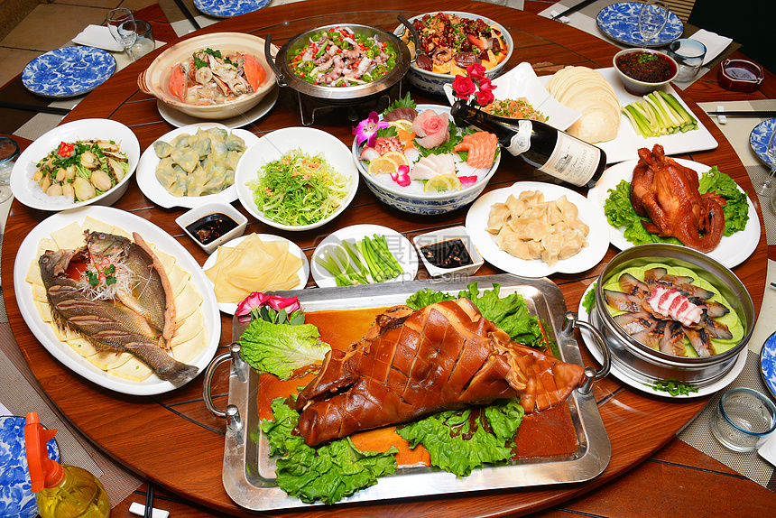
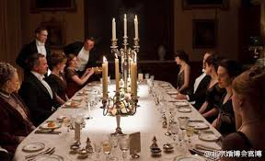
Basic Guidelines - Functionality
Design for multi-languages.
Functionality.

Slide 21
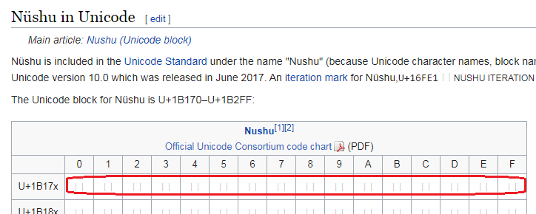
Basic Guidelines - Unicode
Design for multi-languages.
Encoding/Character set: Unicode.
But…
https://en.wikipedia.org/wiki/N%C3%BCshu

Slide 22
Basic Guidelines - Complete and Meaningful String
Keep string and sentence complete and meaningful. Do not split or cut sentence.
Bad: Split the sentence.
"Hi " + "Wade" + ", are you ready to race?"
L10N resource
{ "001": "Hi ", "002": "Internationalization (i18n) and localization (L10n)", "003": "Internationalization is the process of designing a software application", "004": "Not only picking i18n framework & apply it to front-end codebase", "005": "technical requirements", "006": ", are you ready to race?", }

Slide 23
Basic Guidelines - Complete and Meaningful String
Make sentence complete and meaningful. Do not split or cut sentence. Use variables.
Better: Keep the sentence complete, and apply variables.
"Hi ${playerName}, are you ready to race?"
L10N resource
{ "001": "Hi ${playerName}, are you ready to race?", "002": "Internationalization (i18n) and localization (L10n)", "003": "Internationalization is the process of designing a software application", "004": "Not only picking i18n framework & apply it to front-end codebase", "005": "technical requirements", }

Slide 24
Basic Guidelines - Complete and Meaningful String
Keep sentence complete and meaningful.
Question | Answer
What kinds of games does Alice play?
What kinds of drinks does Alice want?
What kinds of movies does Alice like?
What kinds of dogs does Alice have?

Slide 25
Basic Guidelines - Complete and Meaningful String
Make it as template?
Option A | Option B
UserName = Alice; Data = [ { 0: game, 1: play }, { 0: drinks, 1: want }, { 0: movies, 1: like }, { 0: dogs, 1: have }, ]; Loop in Data: output: What kinds of {0} does ${UserName} {1}? | UserName = Alice; Data = [ { 0: What kinds of games does ${UserName} play? }, { 0: What kinds of drinks does ${UserName} want? }, { 0: What kinds of movies does ${UserName} like? }, { 0: What kinds of dogs does ${UserName} have? }, ]; Loop in Data: output {0}

Slide 26
Basic Guidelines - Complete and Meaningful String
Make it as template?
English | Japanese
What kinds of games does Alice play? | アリスはどのようなゲームをやっていますか？
What kinds of drinks does Alice want**? | アリスはどんな飲み物を飲みたいですか？
What kinds of movies does Alice like? | アリスはどんな映画が好きですか？
What kinds of dogs does Alice have? | アリスにはどんな犬がいますか？
English | Japanese | Chinese
Want to drink (2 verbs) | 飲みたい (1 verb) | 想喝 (2 verbs)

Slide 27
Basic Guidelines - Grammar Matters
l10n resource is NOT template between different sentences.
Grammar matters
Leave grammer in l10n resource, and let translator handle it.
English: Loading network configuration
French: Chargement de la configuration du réseau
Verb -ing
Progressive tense
Noun

Slide 28
Basic Guidelines - Grammar Matters
l10n resource is NOT template between different sentences.
Grammar matters
Leave grammer in l10n resource, and let translator handle it.
English: Invalid license
French: Licence non valide
Object + Adverb + Adjective
Adjective + Object

Slide 29
Basic Guidelines
Design for multi-languages. Not only design for English/native language but also include other languages/cultures.
Layout.
Color/Font-family
Functionality.
Encoding/Character set: Unicode.
Structure of the program.
Test plane.
No hardcoded. Use variables
Extract all l10n target out of the source code, and put them into l10n resource folder/files.
Keep sentence complete and meaningful.
Do not split sentence.

Slide 30
What needs to be localized?
All displayable words.

Slide 31
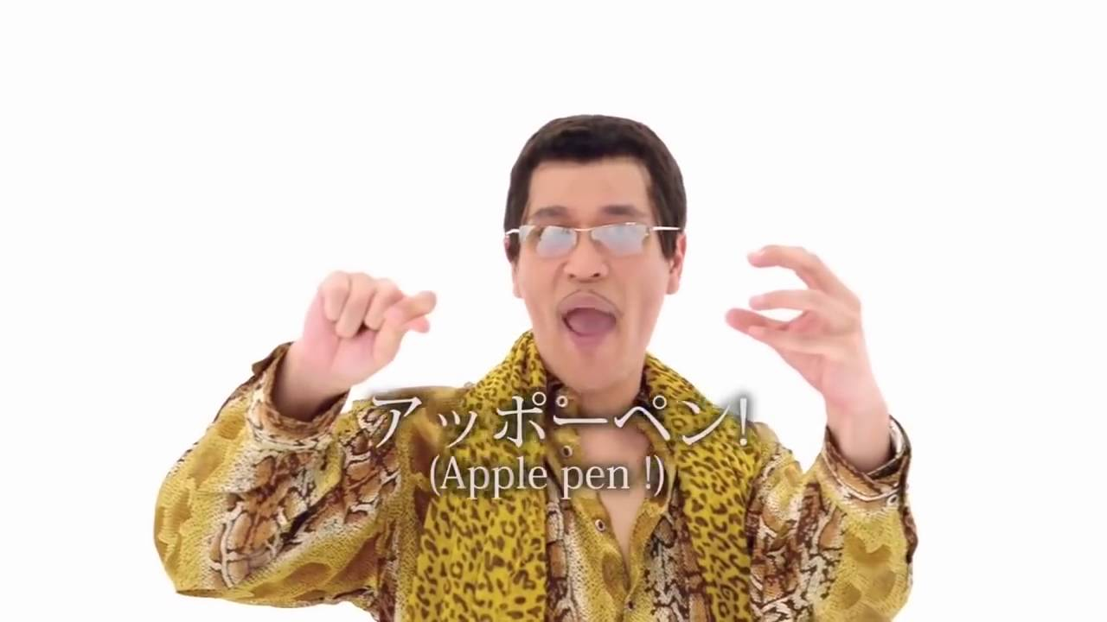
What needs to be localized?
Punctuation.
Comma, Period, Ellipsis, Parentheses...
English: I have a pen, and an apple. Chinese: 我有一枝筆，和一顆蘋果。
Symbols and Signs.
Percent sign, ...
English: 40% chance of rain for Ohio State-Nebraska game
Turkish: Ohio State-Nebraska oyunu için% 40 yağmur ihtimali

Slide 32
What needs to be localized?
Date/Time.
09/06/2019
What date?
USA (mm/dd/yyyy): September 6th
France (dd/mm/yyyy): June 9th
Format matters
https://en.wikipedia.org/wiki/Date_format_by_country

Slide 33
What needs to be localized?
Date/Time.
ISO-8601: 2018-04-05
Taiwan: 民國 107 年 4 月 5 日
Japan: 平成 30 年 4 月 5 日
USA: April 5, 2018

Slide 34
What needs to be localized?
Date/Time.
Timestamp: 1569574800
Taiwan (UTC+8): 17:00
Japan (UTC+9): 18:00
Time zone matters

Slide 35
What needs to be localized?
Numbers with symbols.
12,345
How much?
USA : 12 thousands
France: 12
Format matters
https://en.wikipedia.org/wiki/Decimal_separator#Examples_of_use

Slide 36


What needs to be localized?
Images with wording in it.

Slide 37
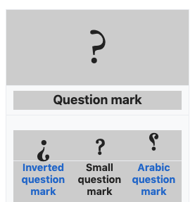

What needs to be localized?
Icon (Sometimes).
Question mark

Slide 38
What needs to be localized?
All displayable sentences.
Punctuation, Symbols and Signs.
Date/Time.
Format (yyyy/mm/dd)
Timezone (UTC+8)
Numbers with symbols.
Decimal point/comma
Thousands Separators
Images with wording in it.
Icons (Sometimes).
Question mark

Slide 39
What does NOT need to be put into l10n resource?
Source code.
Original: To lean more, please check <a here='https://example.com/'>Online help</a>.
Suggest: To lean more, please check ${link__OnlineHelp}.

Slide 40
What does NOT need to be put into l10n resource?
Spical token used by our program.
Original: Use * to represent any series of characters.
We don’t want it become: 使用 ＊ 符號代表任意字元。
(Note: * is not ＊)
Suggest: Use ${token__Asterisk} to represent any series of characters.

Slide 41
What does NOT need to be put into l10n resource?
Dynamic content.
Original: Disk usage: 80%
We cannot list them all.
Suggest: Disk usage: ${number}%

Slide 42
What does NOT need to be put into l10n resource?
Source code.
To lean more, please check <a here='https://example.com/'>Online help</a>.
Spical token.
Use * to represent any series of characters.
Dynamic content.
Disk usage: 80%

Slide 43
Basic Guidelines
Design with i18n and l10n.
All displayable Text, Date/Time, Numbers, Punctuation, Symbols, Signs, Images and Icons (Some cases).
Keep sentence complete and meaningful.
L10N resource is NOT template between different sentences.
Do not include no-need-to-translate element into the l10n resource.
Source code.
Spical token.

Slide 44
Q&A

Slide 45
Thank You

Slide 46
Appendix

Slide 47
Reference
[1] https://wiki.mageia.org/en/What_is_i18n,_what_is_l10n [2] https://blog.mozilla.org/l10n/2011/12/14/i18n-vs-l10n-whats-the-diff/ [3] https://www.w3.org/International/questions/qa-i18n [4] https://developer.mozilla.org/en-US/docs/Mozilla/Localization/Localization_content_best_practices [5] https://www.infragistics.com/community/blogs/b/devtoolsguy/posts/l10n-and-i18n-best-practices [6] https://en.wikipedia.org/wiki/Percent_sign [7] https://en.wikipedia.org/wiki/Date_format_by_country [8] https://en.wikipedia.org/wiki/Decimal_separator#Examples_of_use | [9] https://www.engadget.com/2016/09/30/japans-noisy-iphone-problem/ [10] https://www.infragistics.com/community/blogs/b/devtoolsguy/posts/introduction-to-localization-and-internationalization [11] https://www.infragistics.com/community/blogs/b/devtoolsguy/posts/l10n-and-i18n-best-practices

